Slide 1

eleiX
Let the stars guide you…!!

Slide 2
PROBLEM STATEMENT
To design a celestial themed user interface for streaming platform that replicates the features and functionality of NETFLIX. The UI should include easy navigation, visually appealing images and videos, personalized recommendations, user-friendly search functionality, and intuitive categorization of content. The celestial theme should be integrated throughout the UI, with color scheme and visual design that is consistent and visually appealing .

Slide 3
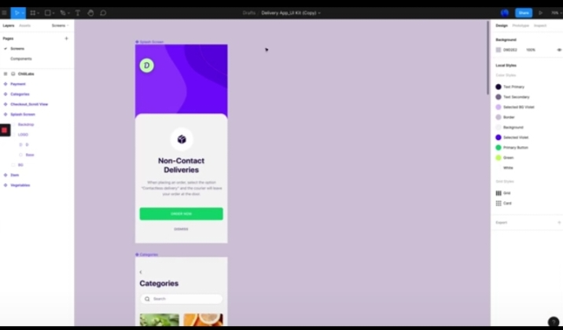
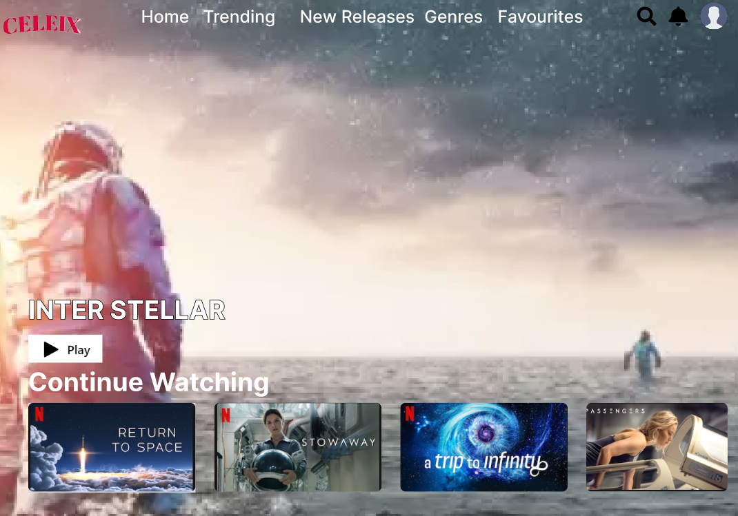
RESEARCH & INSPIRATION
We researched on various movie streaming platforms to find the existing functionalities and took inspiration from NETFLIX in order to make CELEIX . And for designing purpose we go for FIGMA .
RESEARCH
It gives us a great knowledge of advancement in streaming technology and could inspire the development of a replicate service that leverages these innovations to provide a superior user experience
INSPIRATION
we researched on various movie streaming platforms to find the existing functionalities and took inspiration from netflix in order to make celeix ,

Slide 4
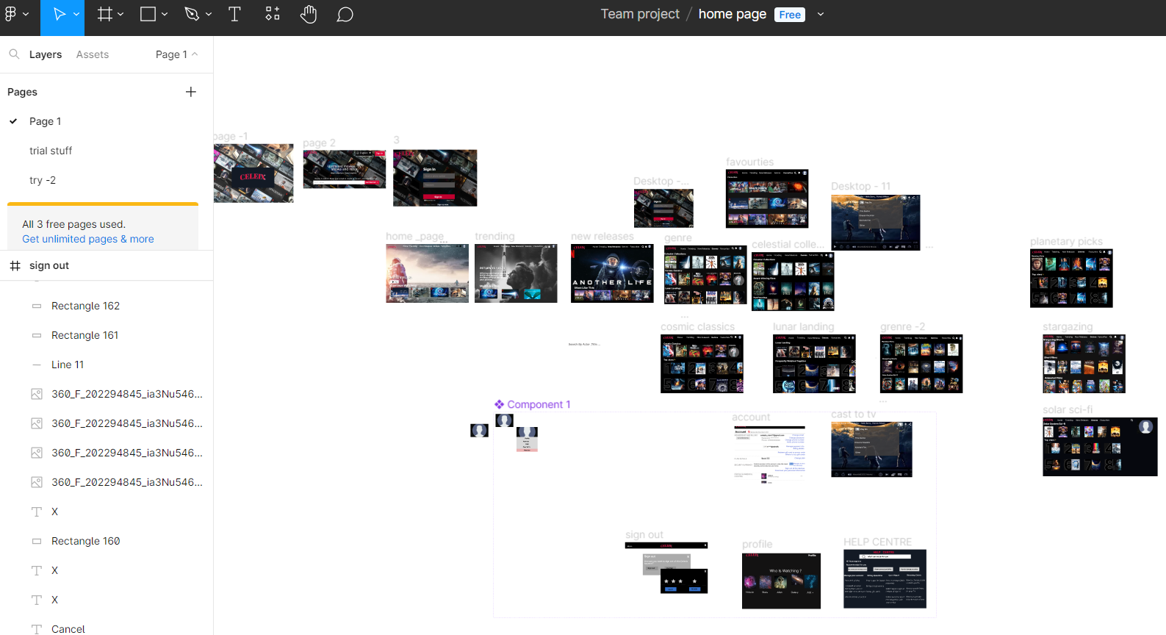
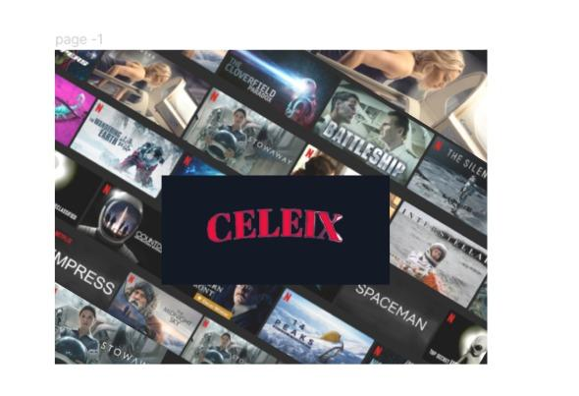
DESIGN PROCESS & ITERATIONS
Defines the problem or opportunity that the design were address. Research and gather information to inform the design. Develop and refine the design concept based on the research.
DESIGN PROCESS
Test the initial design and
gather feedback from stakeholders.
Analyze the feedback and identify areas for improvement. Make revisions to the design and repeat the testing and analysis process until the desired outcome is achieved.
ITERATIONS

Slide 5
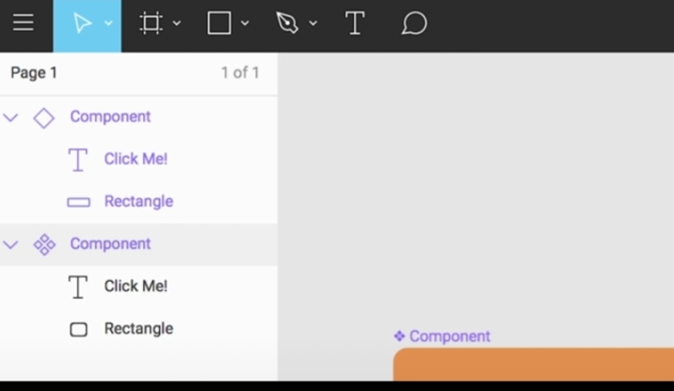

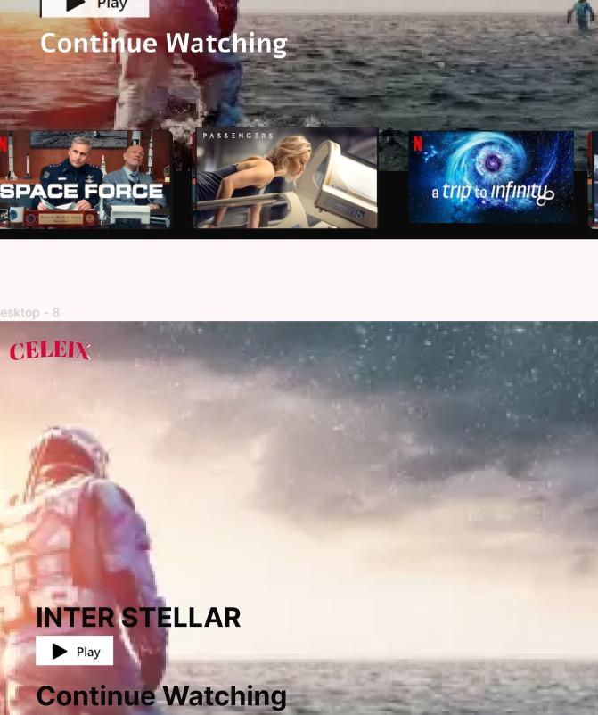
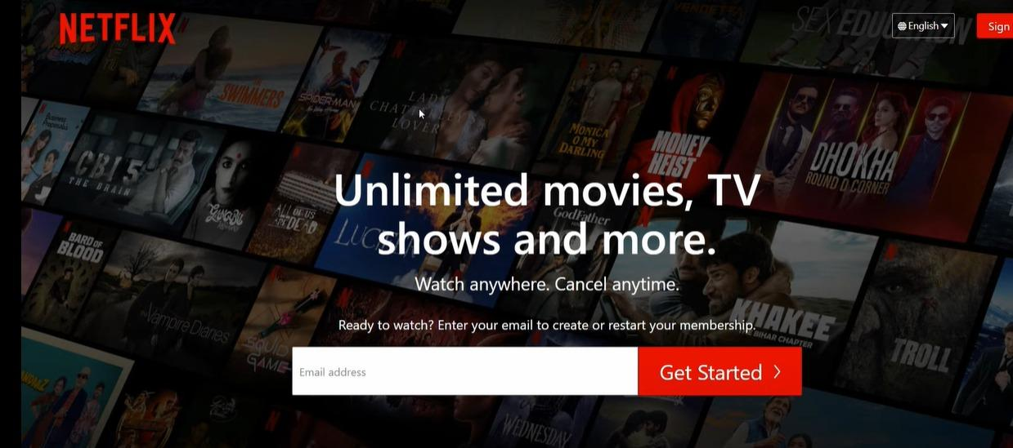
DESIGN SYSTEM

Slide 6
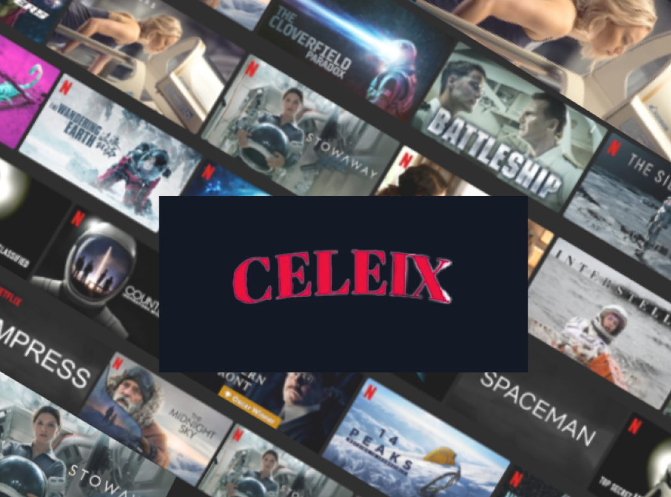
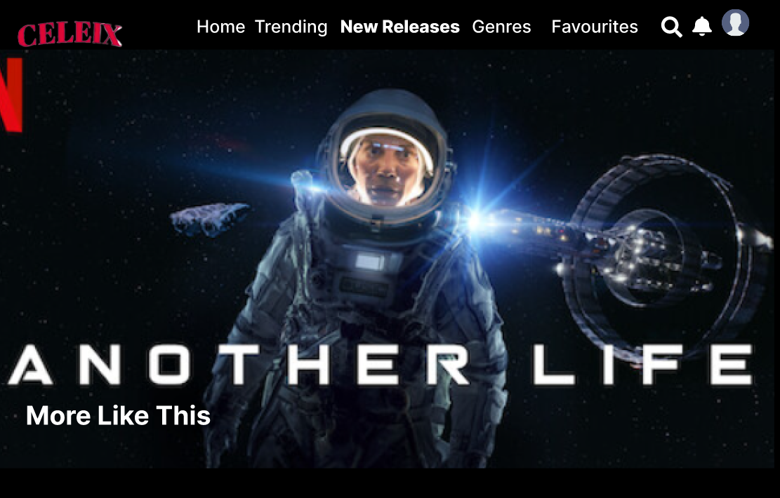
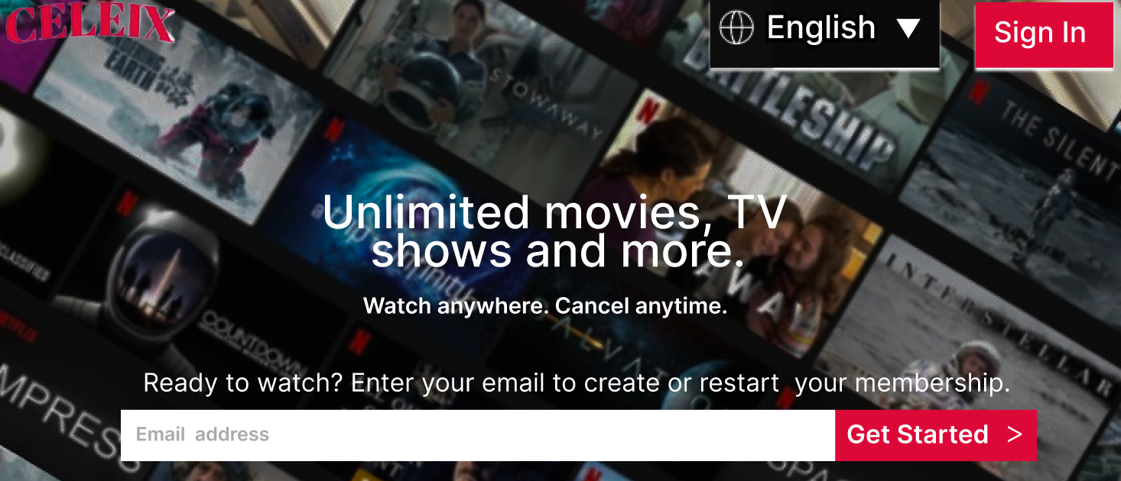
FRONT PAGE
NEW RELEASES
SCREENSHOTS
SIGN IN PAGE
HOME PAGE

Slide 7
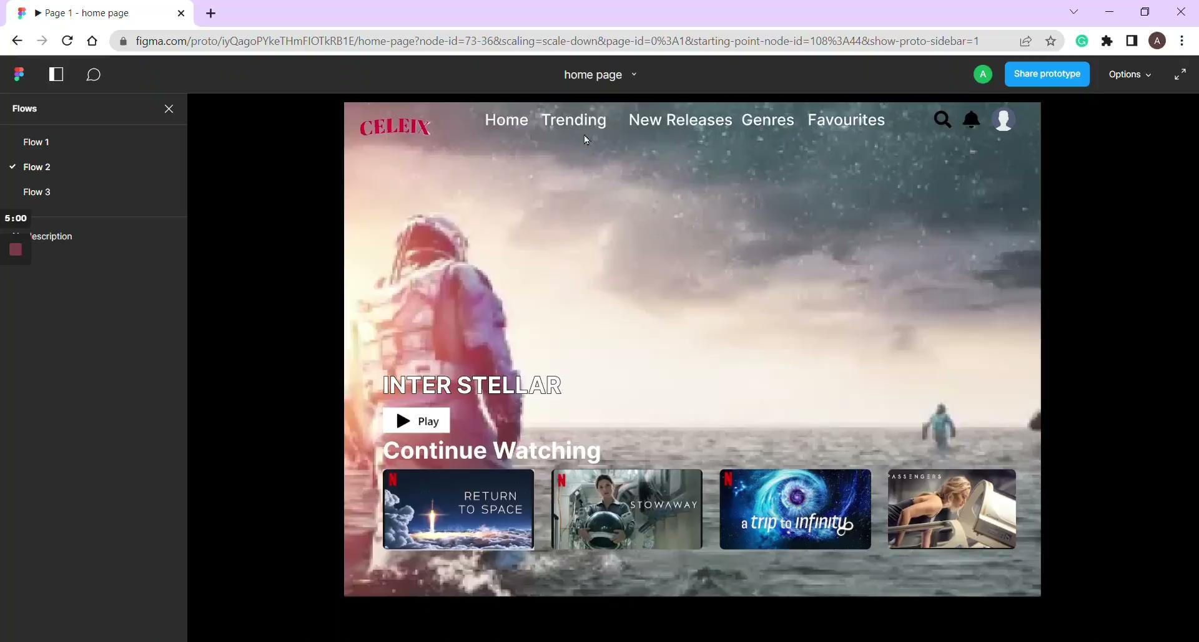
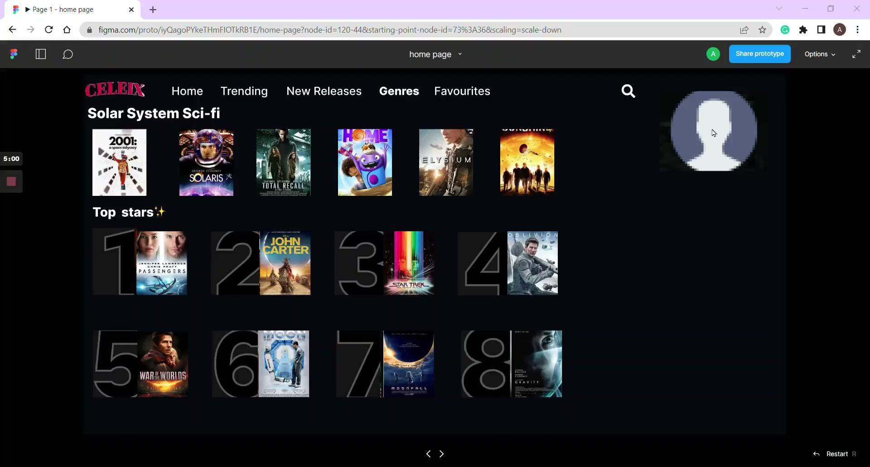
MOCKUPS

Slide 8
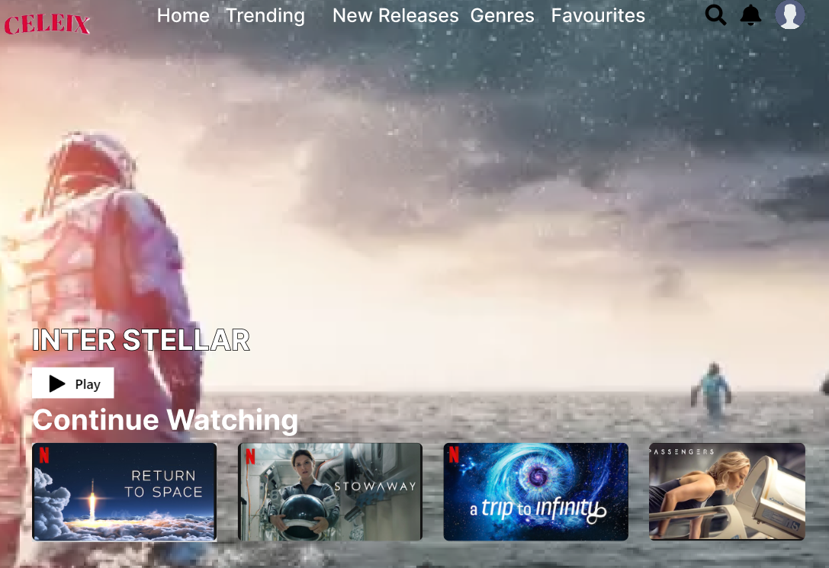
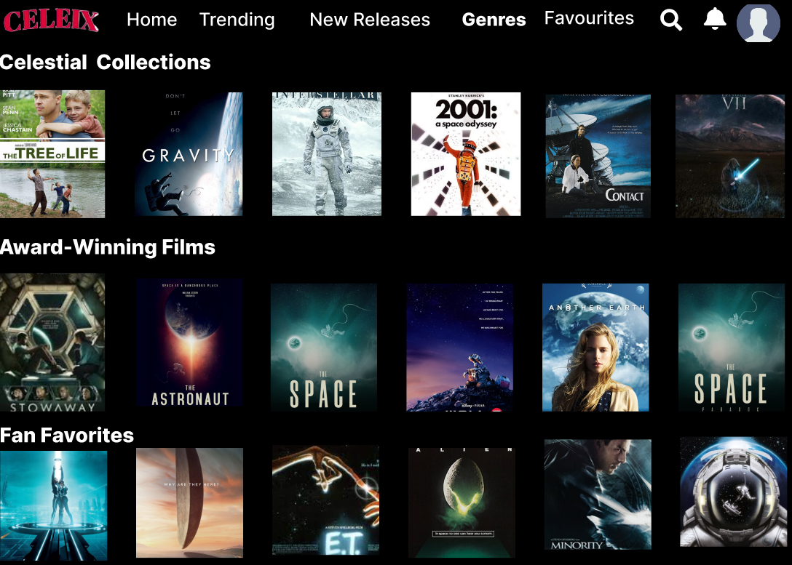
DESIGN DECISIONS AND RATIONALE
Making celeix personalised by having sections such as continue watching and content based on the things watched by the user previously .
Global expansion : CELEIX has content from all over the world starting from local vendors and to big production houses, which can make it the preferred space content streaming platform for users all over the world.

Slide 9
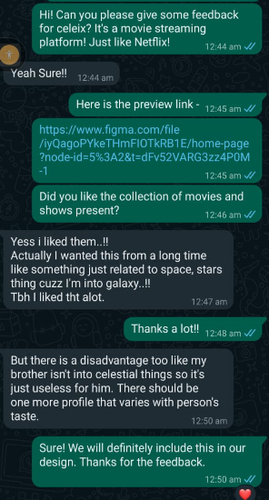
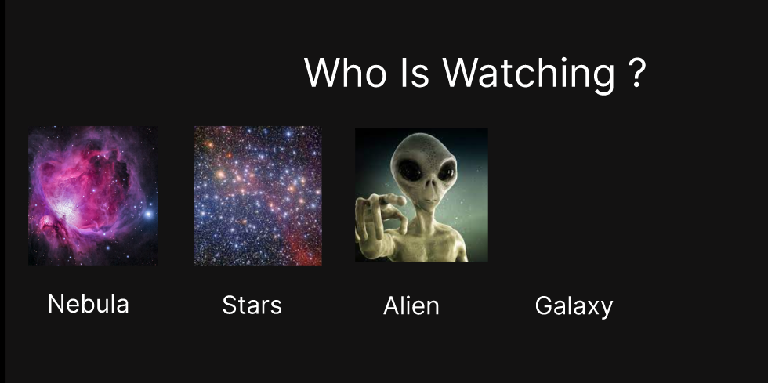
USER FEEDBACK THAT INCORPORATED IN THE DESIGN
A proper profile page to overcome the issue stated
The feedback

Slide 10
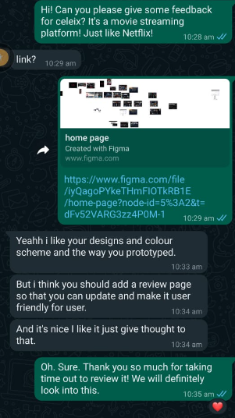
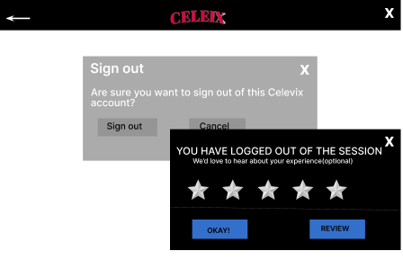
USER FEEDBACK THAT INCORPORATED IN THE DESIGN
Incorporating the same in our sign out page .
The feedback

Slide 11
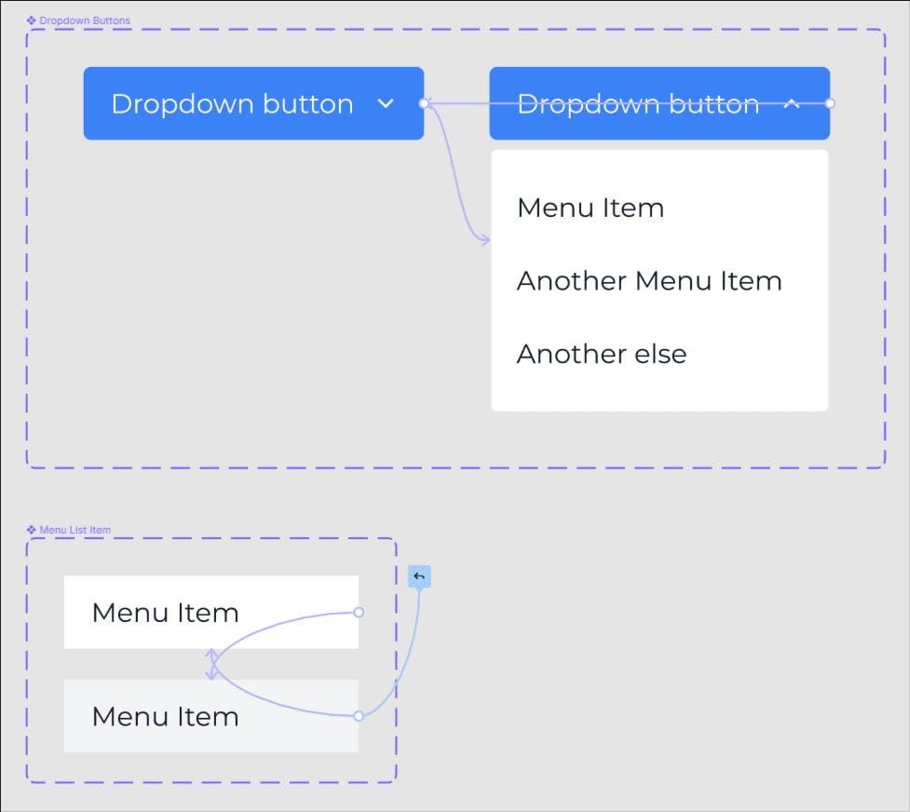
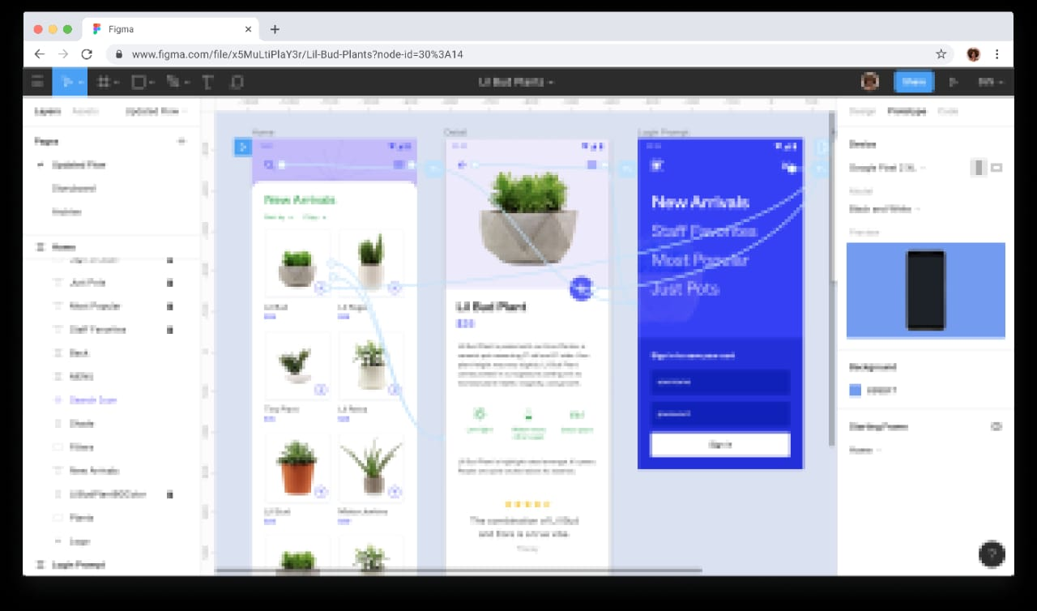
CHALLENGES FACED
USING FIGMA - The initial learning was steep. Figma has a lot of features and functions to master, so it took some time to get up to speed.
MAKING OF DROPDOWN MENU- the drop down menu required different states and frames which was complex to do.

Slide 12
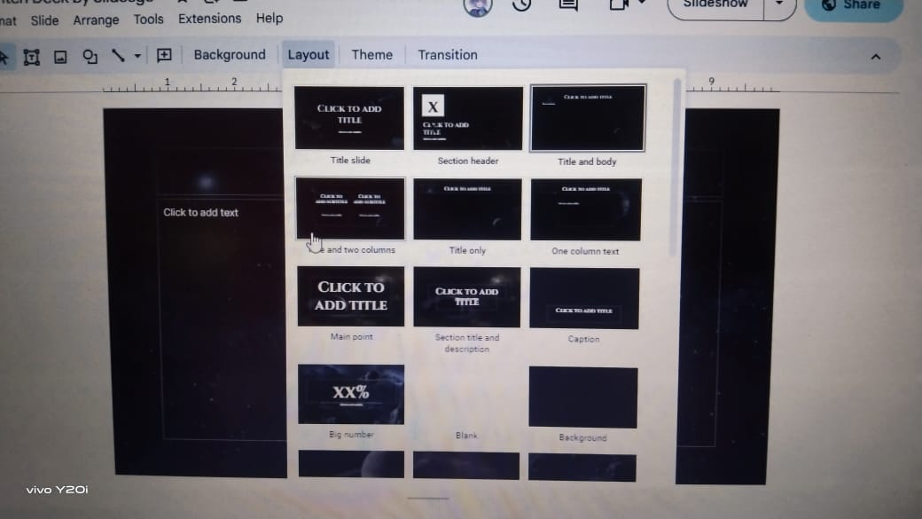
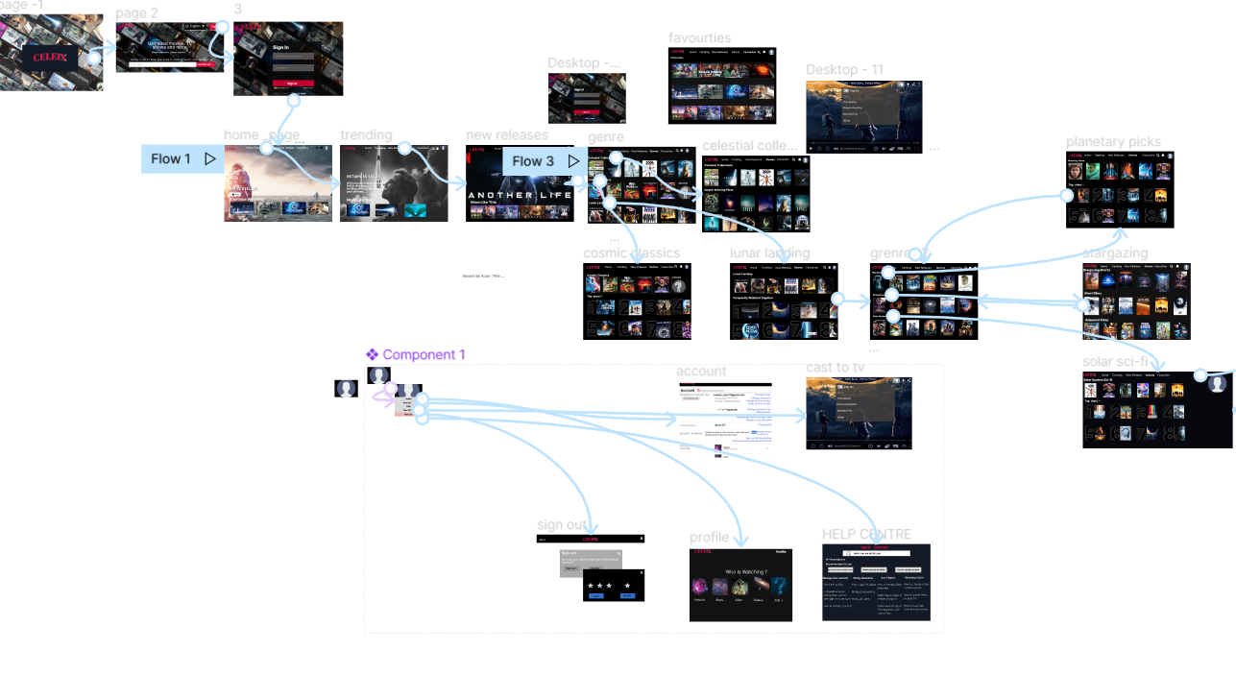
CHALLENGES FACED
PROTOTYPING - Connecting a lot of frames was a difficult task to do.
LOSS PRESENTATION(PPT) - During the making of this presentation all slides suddenly vanished.

Slide 13
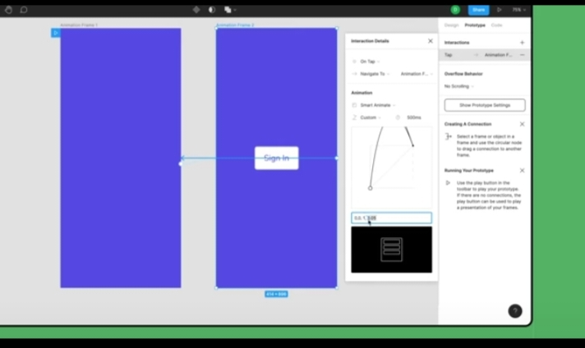
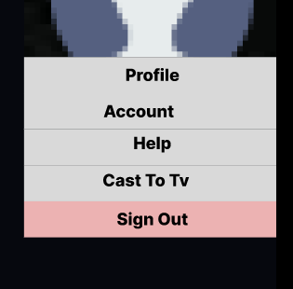
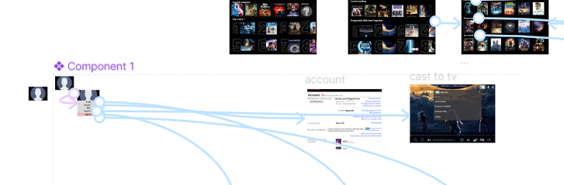
OVERCOMING CHALLENGES
Using google/ learning resources provided by celestial biscuit in order to make the design
The team prototyped it bit by bit making the prototyping easier.
A lot of tutorials and practice was required in order to make the menu

Slide 14
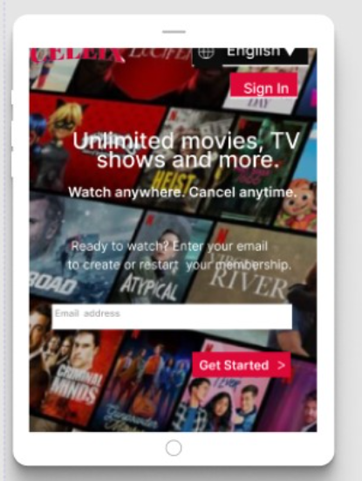
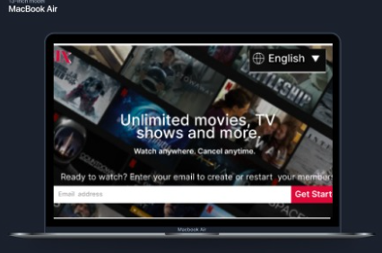
MAKING SURE THAT CELEIX IS COMPATIBLE WITH DIFFERENT DEVICES AS WELL-
Using responsive design principles to ensure that the user interface and layout of the application adapts to the screen size and resolution of the device.
TABLET :
MAC BOOK :

Slide 15
THE PROTOTYPING
Prototyping of Replica of NETFLIX involves creating a preliminary version of the streaming platform that stimulates it’s core functionality and features. These include designing and implementing user interfaces, integrating content delivery systems, and testing the overall performance and user experience.

Slide 16
Future Improvements and Next Steps
1 CELEIX can be the next netflix of space. 2. Using the same design / template we can make a movie streaming platform like netflix but on different themes .
3. People would be able to add movies they made themselves ( RELATED TO SPACE) as well .The video will go through proper checks and evaluations in order to ensure that only space related relevant content goes on celeix.

Slide 17
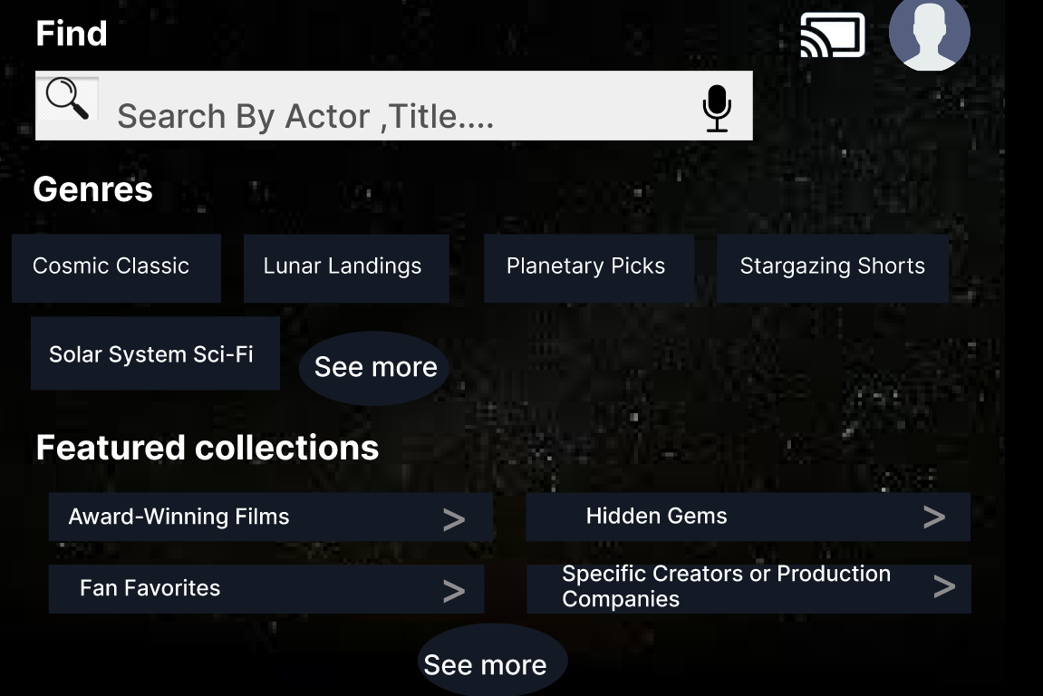
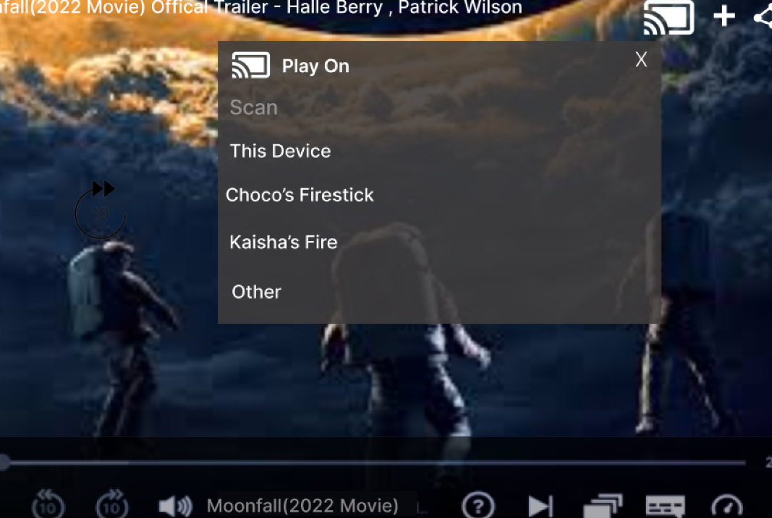
INNOVATIONS & NOVEL APPROACHES
CASTING TO TV FEATURE
A PROPER FIND SECTION WITH ALL CATEGORIES LISTEN FOR EASY ACCESS TO USER

